Slide 1
Common Issues with MCR 6.500 and Other Post Judgment Proceedings

Slide 2
Agenda
Leading Cases Re MCR 6.500
9 Common Issues
How to Minimize Errors (Checklist)
Recent Cases re: 6.500 Motions
Jurisdictional Issues
Rationale Behind Remand Deadlines
A Look into the Future
MCR 6.428 Restoration of Appellate Rights
Record Required for Allowing an Attorney to Withdraw
Motion for Relief from Judgment Flowchart

Slide 3
Leading Cases
People v Cress, 468 Mich 678 (2003)
  Case addresses standards of evaluating newly discovered evidence. The Supreme Court reversed the Court of Appeals decision to grant Cress a new trial.
  The Cress Test comes from this case
  The evidence itself, not just the materiality, was newly discovered
  The newly discovered evidence was not cumulative
  The party, could not, using reasonable diligence, have discovered and produced the evidence at trial
  The new evidence makes a different result probable on re-trial
People v Carp, 496 Mich 440 (2014)
  Decided that the new rules of law could only have retroactive effect if the conviction had not become final
People v Poole, __ Mich App __ (2025)
  Overruled Carp.
  Concluded Parks which found LWOP for Juvenile first degree murder defendants unconstitutional was substantive and therefore applied retroactively. Upheld the holding in People v Parks which applied retroactively because it announced a substantive rule which overruled the state retroactivity analysis in People v Carp (2014).
Notes:
People v Lockridge (2015)
Addressed the application of MCR 6.502(G)(2)
It is printed and in the binder. Let me know if you want it included

Slide 4
Leading Cases, continued
People v Johnson / People v. Scott, 502 Mich 676 (2018)
  Victim murdered May 9, 1999. Defendants convicted at separate trials (one bench / one jury) of 1st Degree Murder. Cooperating government witnesses had many issues. Alcohol. Drugs. Inconsistent statements. Nonetheless – both defendants convicted. One defendant makes multiple post trial petitions. The either none.
  2011, Victim’s son – who was 8 years old at time of murder - eventually comes forward, gives description of person who killed his mother – that is inconsistent with either defendant.
  Full evidentiary hearing. 6.500 relief denied. COA Affirms
  S Ct Reverses in a 5-1 decision. Key statements:
    “a trial court’s credibility determination is concerned with whether a reasonable juror could find the testimony credible.” (at 688)
    “If a witness’s lack of credibility is such that no reasonable juror would consciously entertain a reasonable belief in the witness’s veracity, then the trial court should deny a defendant's motion for relief from judgment. However, if a witness is not patently incredible, a trial court's determination must bear in mind what a reasonable juror might make of the testimony, and not what the trial court itself might decide, were it to be the ultimate fact-finder.”
    Re review when judge did not preside over trial: “Accordingly, the trial court’s determination that …trial testimony was credible need not be afforded any deference by this Court.” (p. 691) Dissent speaks strongly to this conclusion as NOT what the reviewing court did.

Slide 5
Recent Case
People v Boes COA Unpublished July 22, 2025 366916
Majority:
  The trial court denied the defendants successive motion for relief from judgment under MCR 6.502 (G).
  Issue was expert testimony on cause and origin of a house fire and false confessions
  Petition was not the defendants first time appealing her conviction in this case.
  The newly discovered evidence was the validity and admissibility of her statements to police made during her interrogation and the validity of the expert testimony given by the prosecution’s fire origin and causation experts.
  Trial Court denied 6.500 hearing challenging 2003 murder conviction
  If there is newly discovered evidence there has to be a determination of whether or not the evidence would make a different result probable on retrial and whether the evidence is credible and what a reasonable juror might think. When making this decision the trial court has to remember they are not the ultimate fact finder.
  The COA concluded the order should be vacated and remanded for an evidentiary hearing
Dissent
  Concurs with the majority’s opinion that an evidentiary hearing should have been granted on cause and origin but not on false confessions

Slide 6
Concise Statement of Reason for Denial Cases
People v Finnie, 504 Mich 968 (2019)
  The COA vacated Circuit Court’s denial of the defendant’s motion for relief from judgment and remanded the case back to the trial court for reconsideration
  The trial court’s reasoning for denying the motion was that the defendants motion was without merit
  The order did not include a “concise statement of the reason for the denial” which is required by MCR 6.504(B)(2) Vacated & Remanded
People v Holmes, 505 Mich 856 (2019)
  The trial court denied the motion because “Defendant has failed to demonstrate good cause and actual prejudice under MCR 6.508(D). Furthermore, defendant’s claims have no merit.”.
  The order did not include a “concise statement of the reason for the denial” which is required by MCR 6.504(B)(2) Vacated & Remanded

Slide 7
Cases
People v Jurewicz, 506 Mich 941 (2020)
The Supreme Court vacated the judgment of the COA and remanded the case to the COA for reconsideration of the defendant’s ineffective assistance of counsel claim under the correct standard
The Supreme Court stated the COA erred in holding that “the failure to call witnesses only constitutes ineffective assistance of counsel if it deprives the defendant of a substantial defense.”
Trial counsel’s failure to call witnesses is analyzed under the same standard as all other claims of ineffective assistance of counsel
Defendant must show:
  “Counsel’s performance fell below an objective standard of reasonableness “
  “But for counsel’s deficient performance there is a reasonable probability that the outcome would be different.

Slide 8
9 Common Issues W/Post Judgment Relief

Slide 9
Issue #1
Misapplying People v Johnson, 502 Mich 541 (2018)
  There has been a failure to apply the “reasonable juror” standard that comes from People v Johnson when assessing new testimonial evidence
  Important to remember:
    Courts are not the ultimate fact finder
    Credibility determinations should be based on what a reasonable juror might credit as true
    Evidence that should be considered is evidence that would be admissible at retrial
Notes:
People v Johnson:
Involved two defendants both defendants convicted of first degree felony murder, assault with intent to rob while armed and carrying or possession of a firearm when committing or attempting commit a felony. Both appealed and the first defendant’s convictions were affirmed on direct appeal and the second defendant had the conviction for assault with intent to rob while armed vacated but the other remaining convictions were affirmed
After this the defendants moved for relief of judgment based on newly discovered evidence. Trial court and COA denied the motions, but the Supreme Court remanded to COA directing the COA to remand the cases to trial court for evidentiary hearing.
The court had to determine if the evidence was credible before deciding if the new evidence would make a different result possible. Since the courts are not the ultimate fact finder it’s credibility determination is concerned with whether a reasonable juror could find the testimony credible on retrial. If the witness lacks credibility that would cause no reasonable juror to take what they are saying as a reasonable belief then the court should deny a defendants motion for relief for judgment, but if the witness is seen as credible so much so that a reasonable juror would believe what they are saying then the court should grant the motion. The Supreme Court decided that the testimony (newly discovered evidence) would have been found credible by a reasonable juror.
Now they can consider the impact that the testimony could have during retrial. It was decided based on the reasonable juror standard that the newly discovered evidence meant that both defendants should have new trials.
The trial court still denied both defendants motions after the evidentiary hearing and the COA affirmed.
People v Boes
Should be included here because the opinion mainly cites People v Johnson (2018)
This case includes a Majority Opinion and a Dissenting Opinion
Majority:
The trial court denied the defendants successive motion for relief from judgment under MCR 6.502 (G).
This is not the defendants first time appealing her conviction in this case. The defendant is appealing based on the fact that she believes that the trial court abused their discretion and that she was entitled to relief from judgment based on newly discovered evidence
The newly discovered evidence was the validity and admissibility of her statements to police made during her interrogation and the validity of the expert testimony given by the prosecution’s fire origin and causation experts.
If there is newly discovered evidence there has to be a determination of whether or not the evidence would make a different result probable on retrial and whether the evidence is credible and what a reasonable juror might think. When making this decision the trial court has to remember they are not the ultimate fact finder. This trial court decided that evidence was not credible which was why they denied the motion
The COA concluded that the trial court did abuse their discretion by denying defendant’s successive motion for relief from judgment without holding an evidentiary hearing.
The trial court extended their gatekeeping role and also did not take into consideration what a reasonable juror might make of the testimony at retrial.
The COA ordered that the order should be vacated and remanded for an evidentiary hearing
Dissent
This opinion concurs with the majority’s opinion that an evidentiary hearing should have been granted.
The judge dissents the part of the opinion that found that the trial court abused its discretion when it denied the defendant’s motion seeking relief from judgment on the basis of her pretrial statements and believes that the false confessions should not be a part of the hearing.
The dissent agrees the factual and procedural history in the majority opinion

Slide 10
Issue #2
Applying People v Cress, 468 Mich 678 (2003)to decide whether a claim of new evidence survives the procedural bar of MCR 6.502(G)
  The Cress test does not apply to this procedural hurdle
    See People v Watkins, 500 Mich 851 (2016), citing People v Swain, 499 Mich 920 (2016)
  BUT that does not mean that the Cress test can not be used at all when it comes to successive 6.500 motions. You may use the Cress test to analyze the substantive merits
    See People v Johnson, 502 Mich at 565-566. This case applies Cress to both an initial 6.500 motion and a successive one
Notes:
People v Watkins
In this case the circuit court erred in applying People v Cress to an analysis of whether the defendant’s motion was improperly successive under MCR 6.502(G). They decided that Cress does not apply to the procedural threshold of MCR 6.502(G)(2) because the plain text of the court rule does not require that a defendant satisfy all elements of the test. Defendant provided a claim of new evidence that was not discovered before the first motion for relief from judgment.
The Supreme Court vacated the COA order and remanded the case back to the Wayne Circuit Court of reconsideration
People v Swain is explained on Slide 6
People v Johnson is explained in the previous slide

Slide 11
Issue #3
Providing an insufficient explanation of the reasons for the denial of the motion, or failing to address issues raised in the motion
  See MCR 6.508(E); People v Finnie, 504 Mich 968 (2019); People v Holmes, 505 Mich 856 (2019)
Notes:
MCR 6.508(E):
The court, either orally or in writing, shall set forth in the record its findings of fact and its conclusions of law, and enter an appropriate order disposing of the motion
People v Finnie
The COA vacated Circuit Court’s denial of the defendant’s motion for relief from judgment and remanded the case back to the trial court for reconsideration
The trial court’s reasoning for denying the motion was that the defendants motion was without merit
The issue is that order did not include a “concise statement of the reason for the denial” which is required by MCR 6.504(B)(2)
People v Holmes
The original application for leave to appeal was held pending the decision in People v Straughter, 504 Mich. 930 (2019). There was an order from COA having leave of appeal denied in Straughter (2019) so the application for People v Holmes is considered once again.
The COA vacated the order of the Wayne Circuit Court denying the defendants motion for relief from judgment and they remanded the case to the trial court for consideration
The trial court’s reasoning for denying the motion was that “Defendant has failed to demonstrate good cause and actual prejudice under MCR 6.508(D). Furthermore defendant’s claims have no merit.”.
The issue is that the order did not include a “concise statement of the reason for the denial” which is required by MCR 6.504(B)(2)

Slide 12
Issue #4
Applying the preclusion doctrines instead of the provisions of MCR subchapter 6.500
  These preclusion doctrines include:
    Res judicata
    Collateral-attack doctrine
    Law of the case
  Important to note that if res judicata worked as a bar, we would not be here today

Slide 13
Issue #5
Relying on the overruled “substantial defense” language on claims of ineffective assistance based on the failure to call witnesses
  See People v Jurewicz, 506 Mich 914 (2020)
    The defendant was not required to show, in order to obtain relief for ineffective assistance of counsel, that trial counsel's failure to call witnesses deprived him of a substantial defense. Rather, a claim of ineffective assistance of counsel premised on the failure to call witnesses is analyzed under the same standard as all other claims of ineffective assistance of counsel
  Should be using the two prong Strickland Analysis
    Counsel’s performance fell below an objective standard of reasonableness
    If it was not for the counsel’s deficient performance there is a reasonable probability that the outcome would be different
Notes:
Quote that Mr. Weed’s memo had from People v Jurewicz:
“The defendant was not required to show, in order to obtain relief for ineffective assistance of counsel, that trial counsel's failure to call witnesses deprived him of a substantial defense. Rather, a claim of ineffective assistance of counsel premised on the failure to call witnesses is analyzed under the same standard as all other claims of ineffective assistance of counsel [i.e., under the two-prong Strickland analysis]. . . .”).
People v Jurewicz
The Supreme Court vacated the judgment of the COA and remanded the case to the COA for reconsideration of the defendant’s ineffective assistance of counsel claim under the correct standard
The Supreme Court claimed the COA erred in holding that “the failure to call witnesses only constitutes ineffective assistance of counsel if it deprives the defendant of a substantial defense. This is not correct. The defendant was not required to show that trial counsel’s failure to call witnesses is analyzed under the same standard as all other claims of ineffective assistance of counsel
The two things the counsel is required to show is that: “Counsel’s performance fell below an objective standard of reasonableness “ and “but for counsel’s deficient performance there is a reasonable probability that the outcome would be different.
When the cases is on remand the COA should resolve the defendant’s claim of ineffective assistance of counsel under this standard

Slide 14
Issue #6
Failing to correctly apply amendments to MCR 6.502(D) regarding recharacterization pro se motions
  See MCR 6.502(B)(G)
    When a pro se defendant files his or her first motion effectively seeking to set aside or modify the judgment but styles the motion as something other than a motion for relief from judgment, the court shall promptly notify the defendant of its intention to recharacterize the pleading as a motion for relief from judgment; inform the defendant of any effects this might have on subsequent motions for relief, see MCR 6.502(B), (G); and provide the defendant 90 days to withdraw or amend his or her motion before the court recharacterizes the motion. If the court fails to provide this notice and opportunity for withdrawal or amendment, or the defendant establishes that notice was not actually received, the defendant's motion cannot be considered a motion for relief from judgment for purposes of MCR 6.502(B), (G). The clerk of the court shall retain a copy of the motion.”
Notes:
Quote from MCR 6.502(D).
“When a pro se defendant files his or her first motion effectively seeking to set aside or modify the judgment but styles the motion as something other than a motion for relief from judgment, the court shall promptly notify the defendant of its intention to recharacterize the pleading as a motion for relief from judgment; inform the defendant of any effects this might have on subsequent motions for relief, see MCR 6.502(B), (G); and provide the defendant 90 days to withdraw or amend his or her motion before the court recharacterizes the motion. If the court fails to provide this notice and opportunity for withdrawal or amendment, or the defendant establishes that notice was not actually received, the defendant's motion cannot be considered a motion for relief from judgment for purposes of MCR 6.502(B), (G). The clerk of the court shall retain a copy of the motion.”

Slide 15
MCR 6.502(D) – Return of Insufficient Motion
If a motion is not submitted on a form approved by the State Court Administrative Office, or does not substantially comply with the requirements of these rules, the court shall either direct that it be returned to the defendant with a statement of the reasons for its return, along with the appropriate form, or adjudicate the motion under the provisions of these rules. When a pro se defendant files his or her first motion effectively seeking to set aside or modify the judgment but styles the motion as something other than a motion for relief from judgment, the court shall promptly notify the defendant of its intention to recharacterize the pleading as a motion for relief from judgment; inform the defendant of any effects this might have on subsequent motions for relief, see MCR 6.502(B), (G); and provide the defendant 90 days to withdraw or amend his or her motion before the court recharacterizes the motion. If the court fails to provide this notice and opportunity for withdrawal or amendment, or the defendant establishes that notice was not actually received, the defendant's motion cannot be considered a motion for relief from judgment for purposes of MCR 6.502(B), (G). The clerk of the court shall retain a copy of the motion.

Slide 16
Issue #7 & 8
Holding that newly discovered impeachment evidence can never be a basis to grant a new trial
  See People v Grissom, 492 Mich 296, 321 (2012)
Also holding that newly available evidence can never warrant a new trial under Cress
  See People v Rao, 491 Mich 271, 279 (2012)
    “This Court has long held that a new trial may be granted on the basis of newly discovered evidence and has applied the same four part test for ruling on such motions for over a century”
Notes:
Quote from People v Grissom:
(“[N]ewly discovered impeachment evidence generally is insufficient to warrant a new trial. However, such evidence may be grounds for a new trial if it satisfies the four-part test set forth in Cress.”).
People v Grissom
After the defendant had affirmance of a rape conviction the defendant moved for relief from judgment based on newly discovered impeachment evidence. The circuit court denied that motion and the defendant moved to appeal and the COA affirmed. The Supreme Court held that the trial court abused its discretion in denying defendant’s motion for relief from judgment based on newly discovered evidence impeaching credibility of rape victim.
The Supreme Court decided that impeachment evidence may be grounds for a new trial if it satisfies the four part test that is in People v Cress. There also needs to be an exculpatory connection between the newly discovered evidence and significantly important evidence presented at trial. The evidence also needs to make a different result probable on retrial
With that being said the case is remanded to the trial court for determination of whether the newly discovered evidence satisfies Cress
Quote from People v Rao:
“When evidence is known to the defendant at the time of trial, but is claimed to have been unavailable, the third part of the Cress test is necessarily implicated because it requires a showing that the defendant ‘could not, using reasonable diligence, have discovered and produced the evidence at trial[.]’ In other words, under Cress, when a defendant is aware of evidence before trial, he or she is charged with the burden of using reasonable diligence to make that evidence available and produce it at trial. A defendant who fails to do so cannot satisfy the first and third parts of the Cress test.”
People v Rao:
The defendant was convicted of second degree child abuse and the Oakland Circuit Court denied defendant’s motion for a new trial based on alleged newly discovered evidence. The defendant appealed this and then the COA reverse and remanded. The state then appealed
The Supreme Court then reversed and remanded because the defendant was aware at the time of trial of the alleged newly discovered evidence and the defendant failed to show that she used reasonable diligence to produce the evidence at trial
The Supreme Court explained that the four part test that come from People v Cress can be used on evidence to grant a new trial. In this case the newly discovered evidence does not past the four part test because this evidence is not newly discovered. The defendant knew about the evidence at the time of trial which violates the first part. Violating the first part also violates the third part of the Cress Test which requires the defendant to undertake reasonable diligence to discover and produce evidence at trial. This court felt that the COA did not follow the principles set forth by the Cress test by overlooking that the defendant knew about the newly discovered evidence at the time of trial.

Slide 17
MCR 6.508(D) – Entitlement to Relief
  “The defendant has the burden of establishing entitlement to the relief requested.” Relief may not be granted if the motion does any of these three things:
    “Seeks relief from a judgment of conviction from a judgment of conviction and sentence that still is subject to challenge on appeal pursuant to subchapter 7.200 or subchapter 7.300”
    “Alleges grounds for relief which were decided against the defendant in a prior appeal or proceeding under this subchapter, unless the defendant establishes that a retroactive change in the law has undermined the prior decision…”
    “Alleges grounds for relief, other than jurisdictional defects, which could have been raised on appeal from the conviction and sentence or in a prior motion…”

Slide 18
Issue # 9
Holding that issues are barred because they were raised on direct review when the issue was either not raised or not decided
MCR 6.508(2)
Often arises in claim of ineffective assistance of counsel

Slide 19
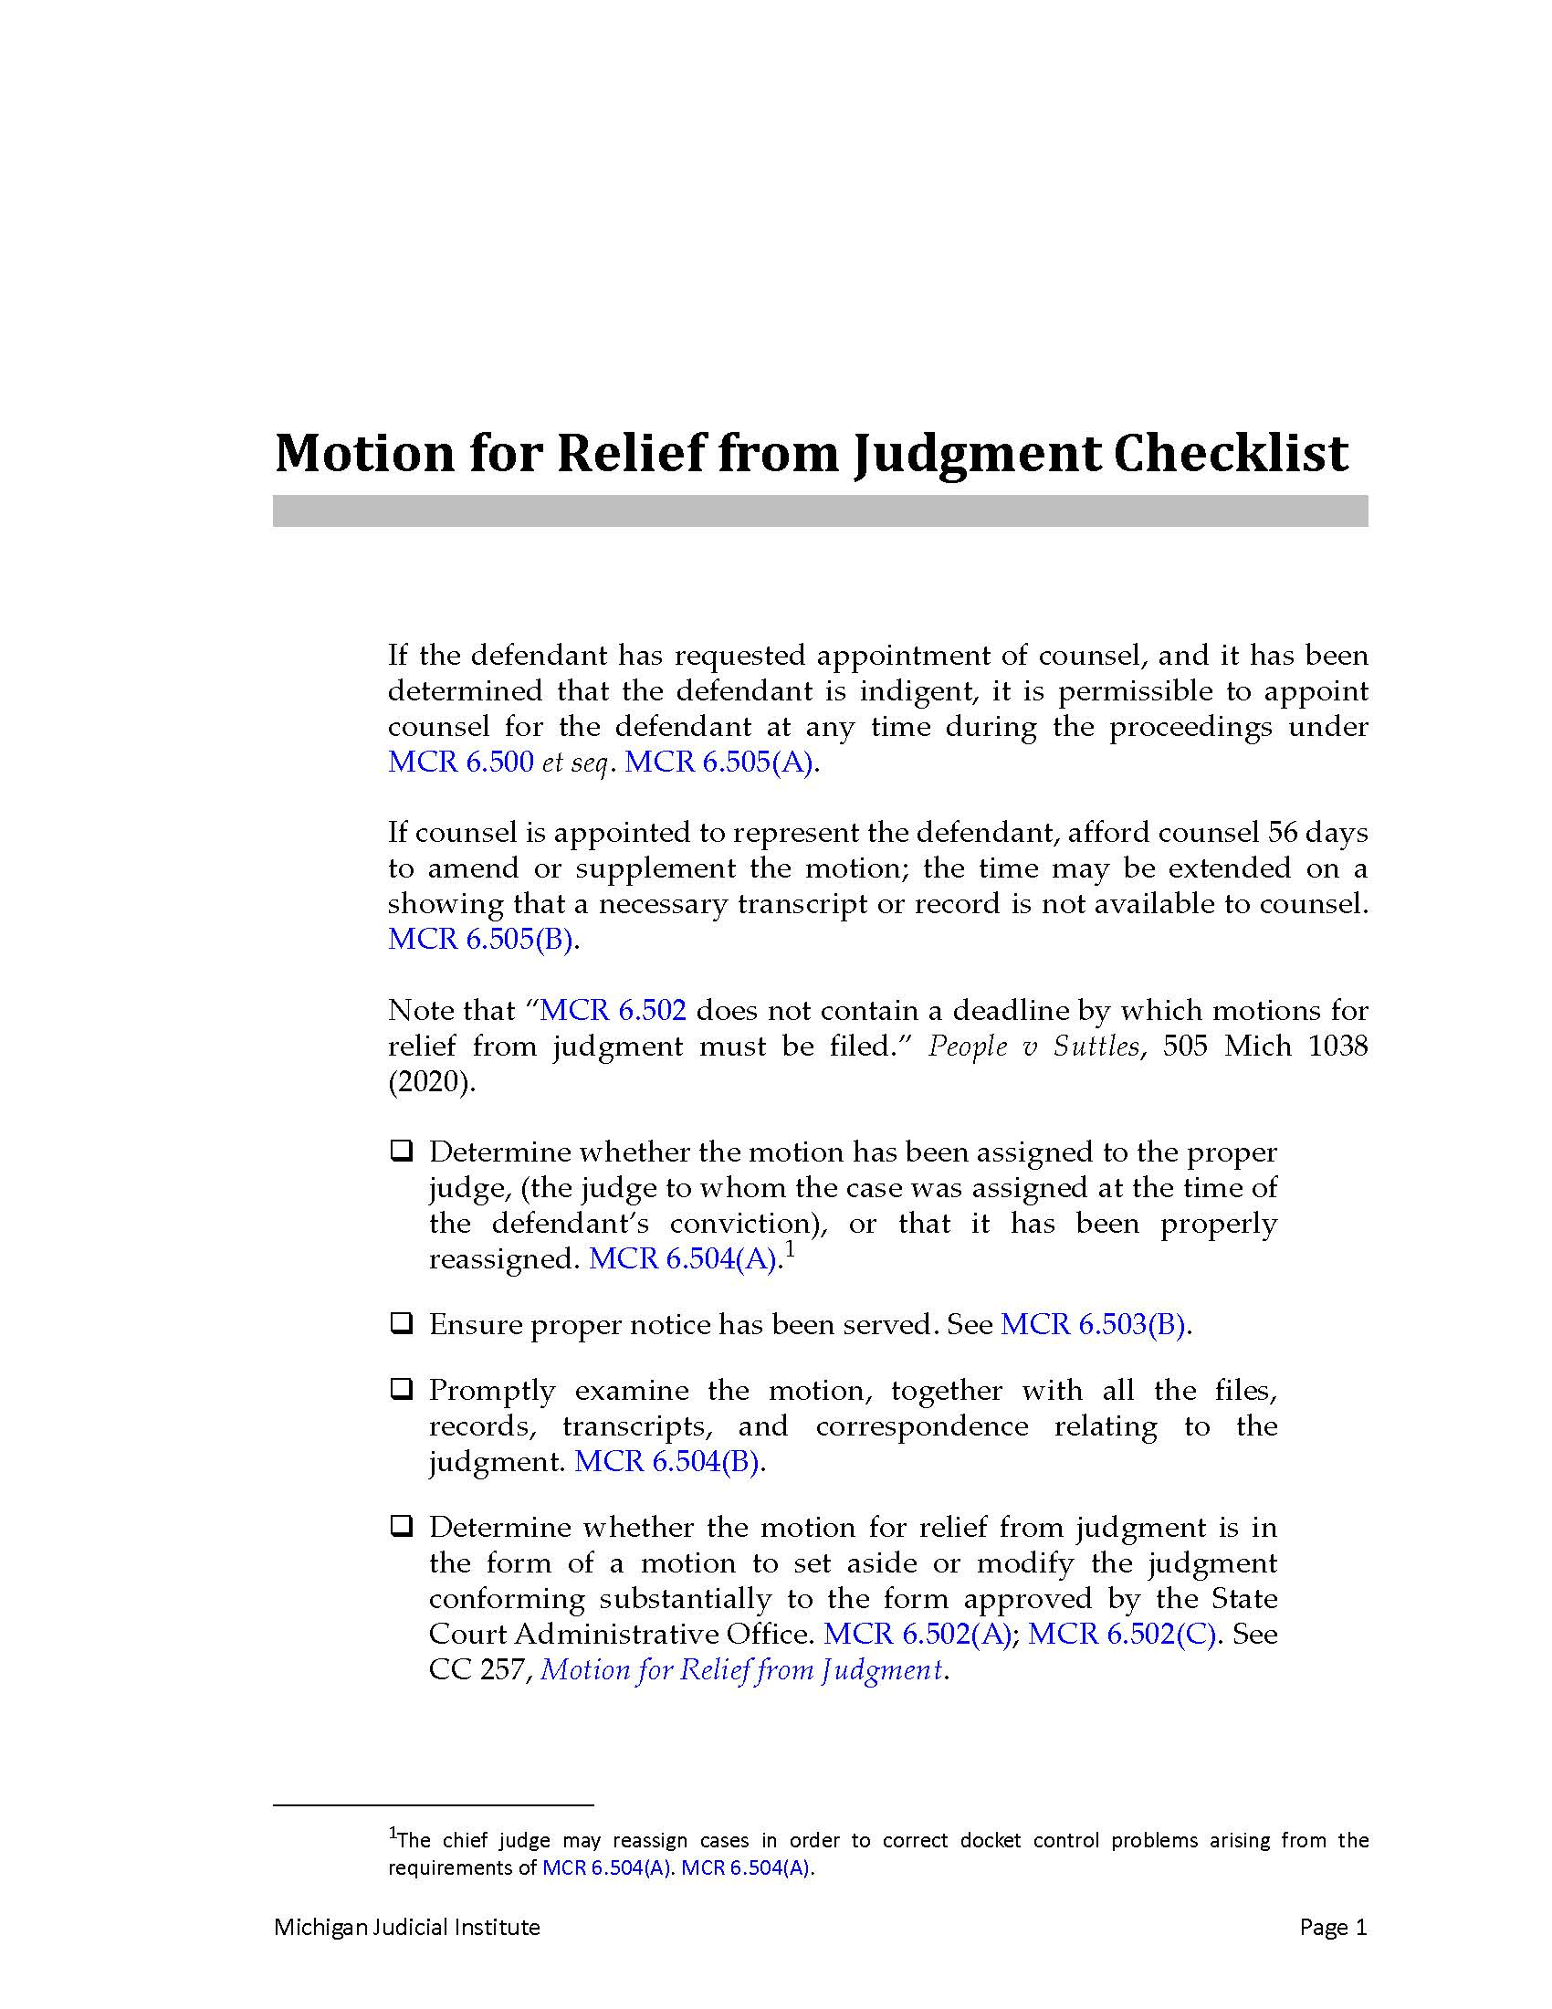
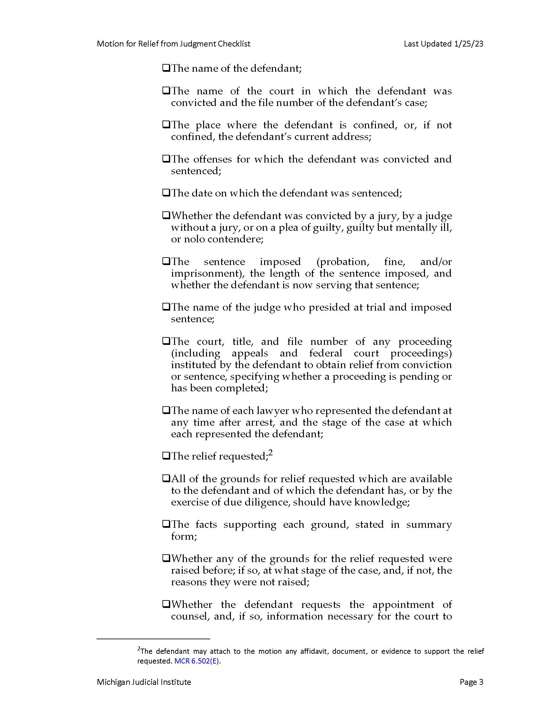
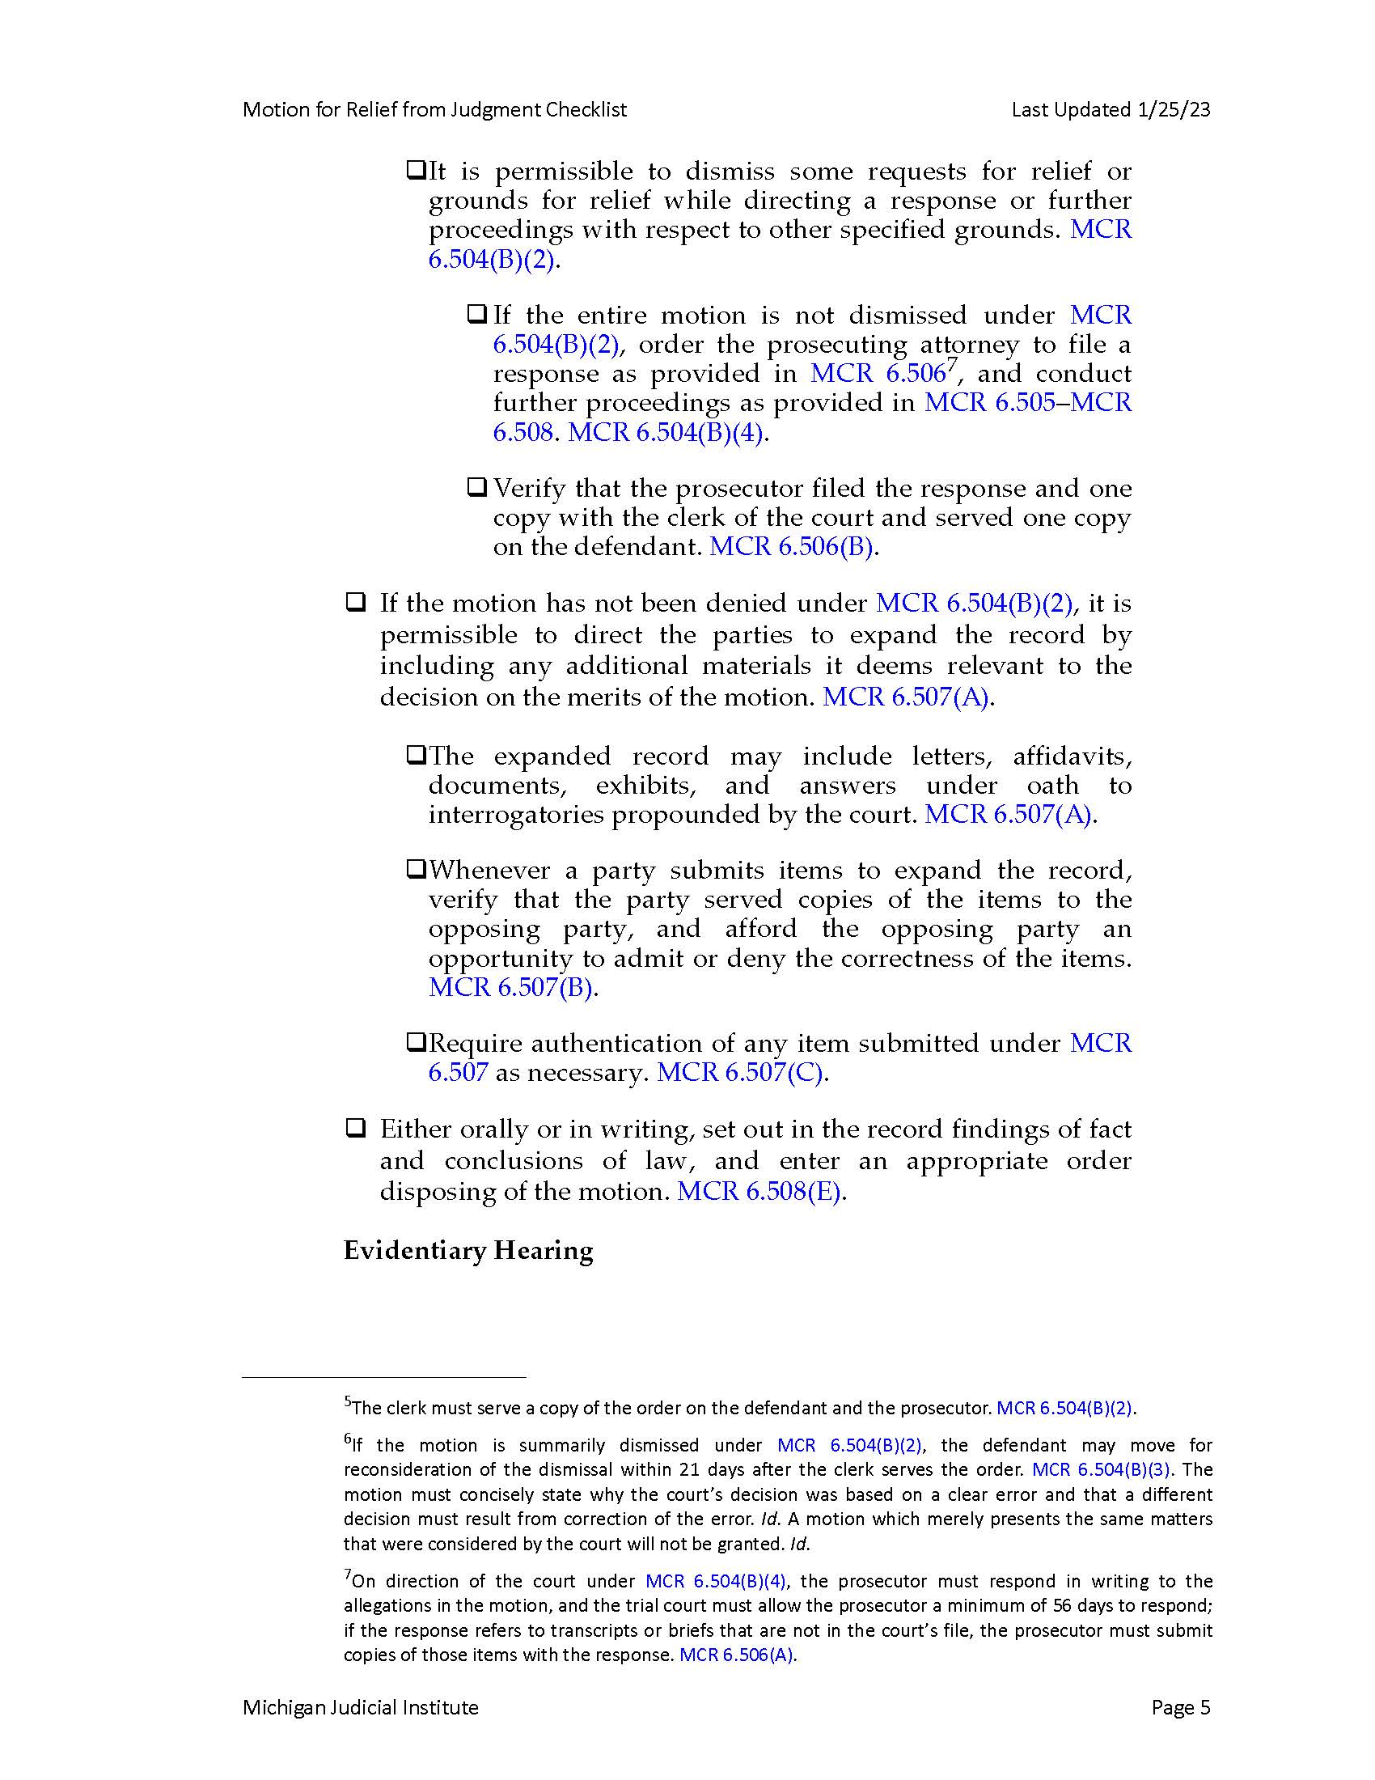
How to Ensure these Errors are not Made
*Handout*

Slide 20
More Recent Cases Dealing with Post Judgment Relief in the Michigan Court of Appeals

Slide 21
Four Cases from 2025
People v Bacall, (COA #369227) Published (2025)
  Defendant moved for relief from judgment based on the introduction of new evidence. This allowed for a successive post conviction motion for relief. Reversed and remanded for further proceedings.
People v Abraham, (COA #364574) Published (2025)
  The defendant was successful on his third motion for relief from judgment (MCR 6.502). The COA affirmed and concluded that the sentence of mandatory LWOP is not cruel or unusual punishment for this defendant.
People v Nard, (COA #369185) Published (2025)
  Defendant was convicted and sentenced to two counts of second degree murder. After People v Stovall, 510 Mich 301 (2022) the trial court resentenced the defendant. The defendant appealed the new sentences. The COA affirmed the trial courts decision.
People v Eads, (COA #357332) Published (2025)
  The defendant was sentenced to LWOP. The defendant was granted a motion for relief from judgment (MCR 6.508(D)) after the Supreme Court remanded it back to the COA. The COA reversed the trial courts decision and vacated the sentence due to the ruling in Miller v Alabama (2012).
Notes:
People v Bacall
The defendant was convicted for first degree murder and carrying a firearm during the act of the felony. The defendant moved for relief of judgment on the basis of newly discovered evidence and prosecutorial misconduct during trial. The Oakland County Circuit Court denied the motion, but the COA reversed and remanded. The COA held that newly discovered evidence made a different result probable on retrial (according to MCR 6.508(D) and the proper remedy was to remand for new trial.
The newly discovered evidence was two witnesses had recanted their testimony.
People v Abraham (2025)
One of your cases
The defendant appeals by leave granted after the trial court’s order denying his third successive motion for relief from judgment. The defendant claimed that the trial court made an error by denying his motion because the mandatory life imprisonment without the possibility of parole violates the Equal Protection Clause. The defendant overcame the procedural bar and was able to file his third successive motion by showing that his claims were based on a retroactive change in law (People v Parks, 510 Mich. 225, 987 (2022)) (MCR 6.502).
When the COA reviewed this case they were looking to see if there was an abuse of discretion when the trial court denied the motion for relief from judgment under MCR 6.508. This occurs when the decision falls outside the range of reasonable and principled outcomes. There is a four fact test used to interpret Michigan’s Cruel or Unusual Punishment Clause. These factors do not favor the defendant.
COA concluded that the sentence of mandatory LWOP is not cruel or unusual punishment for this defendant.
People v Nard (2025)
The defendant (17 years old at the time of the crime) had originally been sentenced to two terms of life with the possibility of parole.
After the Supreme Court ruled in People v Stovall, 510 Mich 301 (2022) that it was cruel or unusual punishment to sentence juvenile offenders to serve life terms that were convicted of second degree murder, there was a new sentencing hearing.
The trial court resentenced the defendant to serve concurrent prison terms of 60 to 150 years.
The defendant appealed the sentence on the basis of cruel and unusual punishment because he was given a sentence that would equal life in prison
The COA affirmed the trial court’s decision
People v Eads (2025)
Defendant filed a motion for relief from judgment 29 years after he was sentenced and convicted of second degree murder and possession of a firearm during the commission of a felony when he was a juvenile. He believed that because of Miller v Alabama and other legal developments his sentence was unconstitutional and disproportionate under the Michigan Constitution. Wayne County Circuit Court denied his motion. Defendant then filed a delayed application for leave to appeal and the COA denied that. The Defendant sought appeal to the Supreme Court. The Supreme Court remanded it back to the COA and ordered the court to consider the appeal as on leave granted.
The COA first had to look at the Procedural Barrier in MCR 6.508(D) and decide if the defendant overcame these procedural barriers. The court decided that he did because the defendants challenge to his sentence was not raised on direct appeal and direct appeal occurred far before Miller v Alabama (which would be enough to establish good cause under MR 6.508(D)). He also showed actual prejudice because he showed that his sentence was invalid.
The COA then decided that due to Miller v Alabama the defendants term of years sentence was invalid under both the Michigan Constitution and our state’s proportionality requirement. The trial court’s order denying the defendant was reversed and the sentence was vacated. The COA remanded this matter back to the trial court.

Slide 22
Four Cases from 2022 - 2025
People v Carter, (SC #167591) (COA #369956) (2025)
  The Supreme Court denied the application for leave to appeal that the COA ordered in 2024 because the defendants motion for relief from judgment is prohibited by MCR 6.502(G).
People v Onumonu, (COA #363065) Unpublished (2024)
  The defendant moved for relief from judgment under MCR 6.501. There was new evidence found. The defendant was granted an evidentiary hearing. The hearing will determine whether or not the defendant is granted a new trial under MCR 6.508(D).
People v Good, 346 Mich. App. 275 (2023)
  Defendant appealed on leave granted the trial court’s order denying the motion for relief from judgment. The COA affirmed in part, vacated in part and remanded for further proceedings under MCR 6.508(D)(3)(a).
People v MacKenzie, (COA #354250) Unpublished (2022)
  The COA denied the case, but the SC remanded the case for a hearing on ineffective assistance of counsel. The defendants motion was not granted because he never showed “good cause and actual prejudice” (MCR 6.508(D)(3)(a)&(b)).
Notes:
People v Carter
The Supreme Court denied the application for leave to appeal that the COA ordered in 2024 because the defendants motion for relief from judgment is prohibited by MCR 6.502(G)
People v Onumonu
Defendant moved for relief from judgment under MR 6.501 and requested his murder conviction be vacated and a new trial
Defendant claimed he received new evidence through FOIA request of Detroit Police Department and in response to the FOIA request their was new information that was withheld from the defense at the time of trial
The trial court decided to order an evidentiary hearing which the COA affirmed
The trial court will decide at the hearing whether or not the defendant is entitled to a new trial under MCR 6.508(D). Once there is a decision either side can appeal and that is when the COA will rule on whether the defendant can have a new trial or not.
People v Good
The defendant filed a motion for relief from judgment. The trial court denied the motion, but the COA affirmed in part, vacated in part and remanded for further proceedings.
Vacated the part of the order that rejected the defendant’s ineffective assistance of counsel claim and remanded the issue to trial court for a determination of whether good cause has been established under MCR 6.508(D)(3)(a)
Affirmed the trial courts decision of not allowing any restitution because the defendant never went into detail about what specifically was occurring
People v MacKenzie
MacKenzie was convicted of attempted murder and aggravated domestic violence. The defendant appealed to the COA unsuccessfully and then to the Supreme Court which caused the case to get remanded the cases for a hearing on ineffective assistance of counsel (People v Ginther, 390 Mich 436; 212 NW2d 922 (1973)). After the Ginther hearing the trial court, COA and Supreme Court all denied relief.
After this defendant filed a motion for relief from judgment under MCR 6.500. The trial court denied this motion and the COA affirmed.
The trial court concluded the defendant’s motion for relief from judgment required the defendant to show “good cause for failure to raise on appeal and actual prejudice from the alleged irregularities that support the claim for relief.” (MCR 5.08(D)(3)(a)&(b)).
The COA affirmed that defendant never established “good cause” and was unable to demonstrate actual prejudice. In order to show actual prejudice the defendant needs to demonstrate that their was a reasonable chance of acquittal.

Slide 23
Jurisdictional Issues Arising After an Appeal has been Filed
23
MCR 7.208 Authority of Court or Tribunal Appealed From
  (A) Limitations. After a claim of appeal is filed or leave to appeal is granted, the trial court or tribunal may not set aside or amend the judgment or order appealed from except
    (1) by order of the Court of Appeals,
    (2) by stipulation of the parties,
    (3) after a decision on the merits in an action in which a preliminary injunction was granted, or
    (4) as otherwise provided by law.
    In a criminal case, the filing of the claim of appeal does not preclude the trial court from granting a timely motion under subrule (B).
  (B) Postjudgment Motions in Criminal Cases.
    (1) Within the time for filing the defendant-appellant’s brief as provided by MCR 7.212(A)(1)(a)(iii), the defendant may file in the trial court a motion for a new trial, for judgment of acquittal, to withdraw a plea, or to correct an invalid sentence.
  (C) Correction of Defects. Except as otherwise provided by rule and until the record is filed in the Court of Appeals, the trial court or tribunal has jurisdiction
    (1) to grant further time to do, properly perform, or correct any act in the trial court or tribunal in connection with the appeal that was omitted or insufficiently done, other than to extend the time for filing a claim of appeal or for paying the entry fee or to allow delayed appeal;
    (2) to correct any part of the record to be transmitted to the Court of Appeals, but only after notice to the parties and an opportunity for a hearing on the proposed correction.
  (G) Stays and Bonds. The trial court retains authority over stay and bond matters, except as the Court of Appeals otherwise orders.
  (H) Matters Pertaining to Appointment of Attorney. Throughout the pendency of an appeal involving an indigent person, the trial court retains authority to appoint, remove, or replace an attorney except as the Court of Appeals otherwise orders.

Slide 24
Jurisdictional Issues Arising After an Appeal continued…
24
  MCR 7.305: Application for Leave to Appeal
    (C) When to File.
      (6) Effect of Appeal on Decision Remanding Case. If a party appeals a decision that remands for further proceedings as provided in subrule (C)(5)(a), the following provisions apply:
        (a) If the Court of Appeals decision is a judgment under MCR 7.215(E)(1), an application for leave to appeal stays proceedings on remand unless the Court of Appeals or the Supreme Court orders otherwise.
        (b) If the Court of Appeals decision is an order other than a judgment under MCR 7.215(E)(1), the proceedings on remand are not stayed by an application for leave to appeal unless so ordered by the Court of Appeals or the Supreme Court.
  Relevant Case Law:
    People v Washington, 508 Mich 107 (2021)
    People v Johnson, 345 Mich App 51 (2022)
    People v Scott, 513 Mich 180 (2024)
    People v Brown (360132, 363314) (2022)
    People v Talley-Ellis (357388) 2020
    People v Wilburn – For Publication (369323) 2025

Slide 25
Rationale Behind Remand Deadlines
25
History
21 vs 56 days
Court of Appeals process for following up on remands
Motions to Extend
Call the Clerk’s Office

Slide 26
A Look into the Future:
Proposed Amendments to MCR 6.508 and MCR 6.509:
  Requires trial courts that make a partial decision to reissue the order after the other issues are decided
  Clarifies that a reissued order constitutes a decision under subchapter 6.500 of the MCR for the purposes of filing an application for leave to appeal with the COA
New forms of technology
  This could allow new forms of evidence to be introduced
Notes:
The proposed amendments of MCR 6.508 and 6.509 would:
MCR 6.508 = Procedure; Evidentiary Hearing; Determination
MCR 6.509 = Availability of Appeal
Requires trial courts that make a partial decision on a postjudgment motion for relief to reissue the order in its entirety after it decides the remaining issues
Clarify that a reissued order constitutes a decision under subchapter 6.500 of the MCR for purposes of filing an application for leave to appeal with the COA
New advancements of technology could include
Advancements in digital footprints
Advancements in AI

Slide 27
Issues Regarding MCR 6.428 Restoration of Appellate Rights
MCR 6.428: Restoration of Appellate Rights
  If the defendant, whether convicted by plea or at trial, was denied the right to appellate review or the appointment of appellate counsel due to errors by the defendant’s prior attorney or the court, or other factors outside the defendant’s control, the trial court shall issue an order restarting the time in which to file an appeal or request counsel.
Relevant Case Law:
  People v Byars, 346 Mich App 554 (2023)
  People v Tardy, 348 Mich App 500 (2023)
  People v Jackson (362496) 2024
  People v Brabon (362453) 2023

Slide 28
Record Required for Allowing an Attorney to Withdraw
A short record or an affidavit from the attorney will always be helpful.
Trial courts are rarely reversed for allowing an attorney to withdraw.
Case Law:
  Sua Sponte Removals
    People v Durfee, 215 Mich App 677 (1996)
    People v Johnson, 215 Mich App 658 (1996)
  Courts Denial of Withdrawal
    People v Jones (352111)
    People v Cook (351522)
  Decisions Affirming Attorney Withdrawal
    People v Watson (338270)
    People v Tillie (340025)
    People v Beverly (339308)

Slide 29
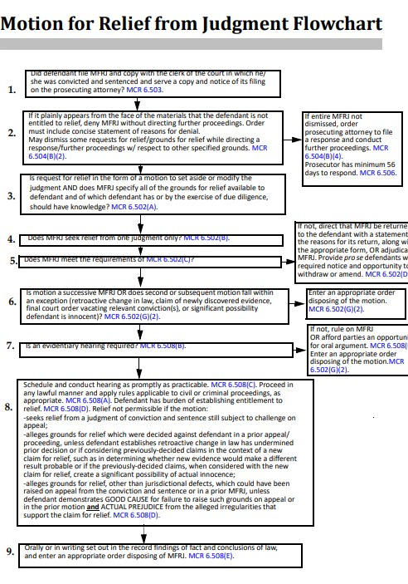
Motion for Relief from Judgment Flow Chart
*Handout*
Notes:
This is potentially the handout

